Slide 1




Next Steps for Language: Language Objectives
Notes:
Presenter Notes:
Welcome participants and take care of any housekeeping issues such as:
location of bathrooms
Schedule
Lunch arrangements
Cell phones
Wireless password

Slide 2


PREPARING FOR SUCCESS IN ALGEBRA DEMONSTRATION CENTER
A Collaboration among:
Los Angeles USD
University of California, San Diego
San Diego State University
University of California, Irvine
Notes:
Presenter Notes:
Let participants know that the materials presented were developed as part of a California Math Science Partnership project involving the district and three universities.
2

Slide 3
Language is a Vehicle to Understand Content
“Learning subject matter and work skills involves using language to structure understanding and core knowledge, to connect concepts with other understanding, and to practice multiple literacy skills within meaningful content-rich activities.”
Alliance for Excellent Education, 2012
Alliance for Excellent Education, 2012

Slide 4

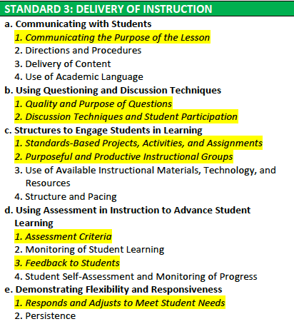
Teaching & Learning Framework
Notes:
Presenter Notes:
Point out that this session will focus on information and activities that support Standard 3: Delivery of Instruction of the LAUSD Teaching and Learning Framework and the mathematics Common Core State Standards.

Slide 5
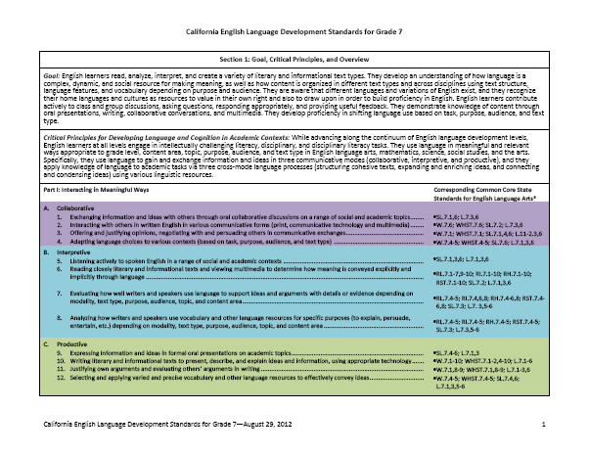
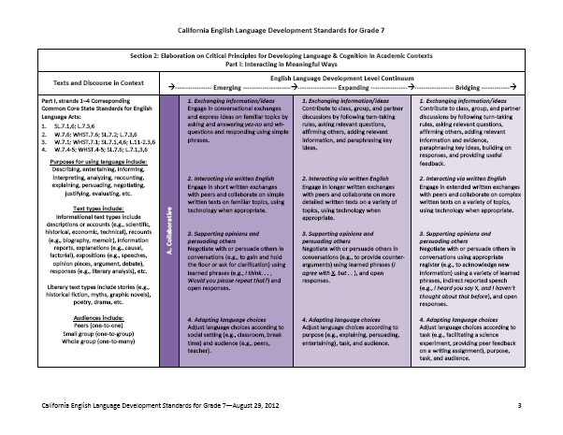
California’s 2012 ELD Standards’ Structure and Components: Grade 7 Example

Slide 6

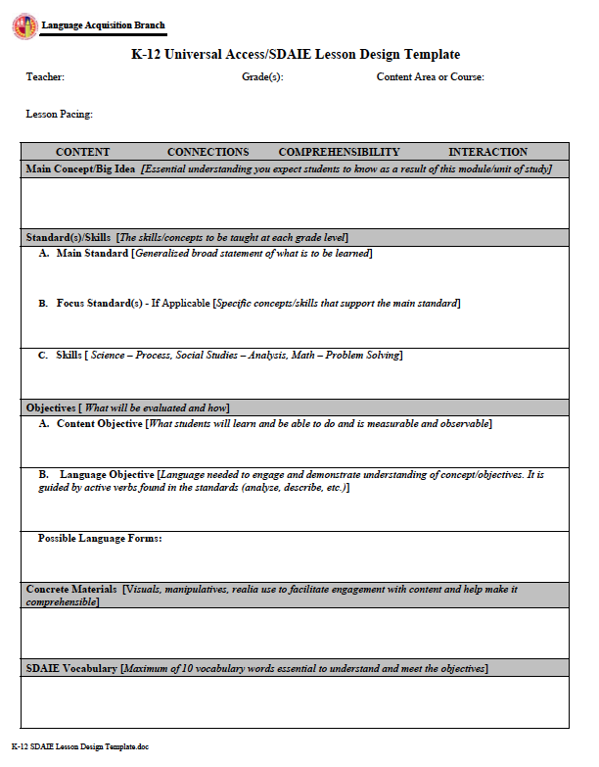
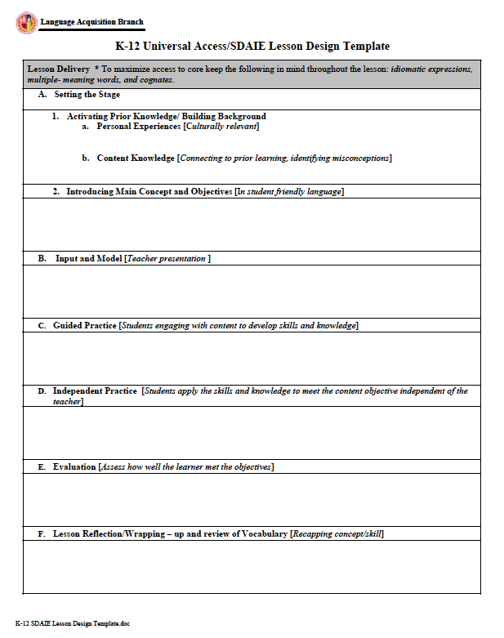

LAUSD SDAIE Lesson Template
Handout: K-12 Universal Access/SDAIE Lesson Design Template
Notes:
Presenter Notes:
Tell the participants that the activities in this module will help them as they develop their lessons plans using the LAUSD K-12 Universal Access/SDAIE Lesson Design Template. The first part will focus in the language objective portion of the template.

Slide 7
Session Objectives
In this session, we will delve deeper into:
The pivotal role of language objectives in fostering students’ conceptual and language development with a focus on language functions and vocabulary development
Teaching mathematics words with multiple meanings, and
Academic vocabulary
Notes:
Presenter Notes:
This module consists of three parts
Part One deals with writing language objectives for mathematics lessons. (40 min.)
You want to have teacher “buy in” to the idea that they are responsible for also having language objectives be part of their mathematics instruction. You can go through the warm-up slides fairly quickly. The discussion is designed to increase awareness of language issues in the teaching of mathematics. It is followed by a discussion of language objectives and practice in writing them. (You will use two handouts.)
Part Two deals with questioning strategies for mathematics lessons. (20 min.)
Questioning strategies will be presented using a mathematics focus and using with a language focus. It will be followed by one of three activities. (You will use two handouts.)
Part Three deals with teaching vocabulary as part of a mathematics lesson. (30 min.)
You will be modeling the steps to teaching vocabulary. (You will use two handouts.)

Slide 8
What am I learning from this session?
K W L
What do I already
KNOW?
What do I WANT
TO KNOW/learn?
What did I learn/
new questions?
Notes:
2 min: Individual Reflection: What did I learn? What new questions do I have?

Slide 9
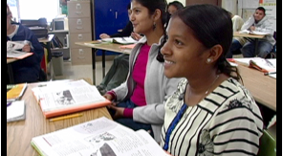
Language Objectives
Notes:
Presenter Notes:
One of your main goals is getting “buy-in” from the participants into the notion that it is important that they teach the language of math to English Learners and others. For this reason, the language objectives section minimizes technical linguistic jargon and examples and presents objectives in a “light” way. Please make sure to show teachers your enthusiasm for teaching the language of mathematics and the necessity of writing language objectives.
Make sure you emphasize that writing language objectives can be easy and should be done each day.
Participants do not have to write new and different ones each day.

Slide 10
Warm Up Task: Word Problems
Identify what words or phrases will cause students difficulty in working with the problem.
Share at least one word or phrase you found and why it would cause difficulty with students.

Slide 11
Warm Up Challenge: What specific words would you teach intermediate-level (Expanding) English learners to help them understand the word problem?
You buy a new stereo for $1,300 and you are able to sell it four years later for $275. Assume that the resale value of the stereo decays exponentially over time. Write an equation giving the stereo’s resale value V (in dollars) as a function of the time t (in years) since you bought it.
Handout: Common Core, Algebra and English Language Development Alignment

Slide 12
Common Core, Algebra and English Language Development Alignment
In a language-rich algebra or mathematics course…
Which words in the problem could cause difficulty for your students; that is, prevent them from understanding the word problem or completing it? | What should you see or hear students do or say in discussing the word problem with a peer to make sure that they have access to the mathematics concepts you are teaching with the problem and to make sure that they are improving their ability to use and understand academic language?
aaaaaaaaaaaaaaaaaaaaaaaaaaaaaaaaaaaaaaaaaaaaaaaaaaaaaaaaaaaaaaaaaaaaaaaaaaaaaa
Handout: Common Core, Algebra and English Language Development Alignment
Notes:
Time: 7 minutes
Intent:
Talking points:
Allow participants 2 minutes to jot down their notes and 4 minutes to discuss their observations with their table groups
Invite volunteers to share their observations on CCSS and 21st century practices
Students were given choices for their project
Students collaborated in teams
Students had the opportunity to interact with each other during the creation of the project
The nature of the assignment provided opportunities for students to communicate with each other in meaningful ways
Students applied their creativity to create their project
Students applied four Cs – creativity, collaboration, communication and critical thinking
Students used rubric to evaluate their peers’ and their own team’s presentations
Students self-reflect on their team’s performance and their own contributions

Slide 13
Selecting the Right Words to Teach is Key
Guiding Questions
Is the word unknown?
Will it improve students’ ability to understand the concepts?
Will students use the word in their assignments?
Will knowledge of the word lead to improvements in students’ knowledge of academic language?
Notes:
Notes for Presenter:
Remind participants that they must thing about which academic words they want to teach.
Going through these guiding questions is instructive.

Slide 14
Selecting Words
Factors to consider:
Words essential to understanding major concepts related to the mathematics topic
Words that are practical for students to know
Words that students are likely to encounter and/or use again (e.g., in other classes)
Words unlikely to be learned by students on their own
Words that advance the students’ knowledge of English
Different selections for different groups of students
Notes:
Remind teachers not to rely on core reading programs or subject textbooks to identify specific words to teach in-depth.
Review the 3 general criteria for factors to consider (Lehr et al. 2004)
Emphasize that there is no right or wrong list of words to choose - in fact, depending on the students in the class, a different set of words might be chosen from the same content reading and lesson. There may not only be a difference from school to school, but even from class to class.

Slide 15

To identify words that challenge your students, you need to look through the lenses of your students.
Notes:
Time: 12 minutes
Intent: Show the video

Slide 16
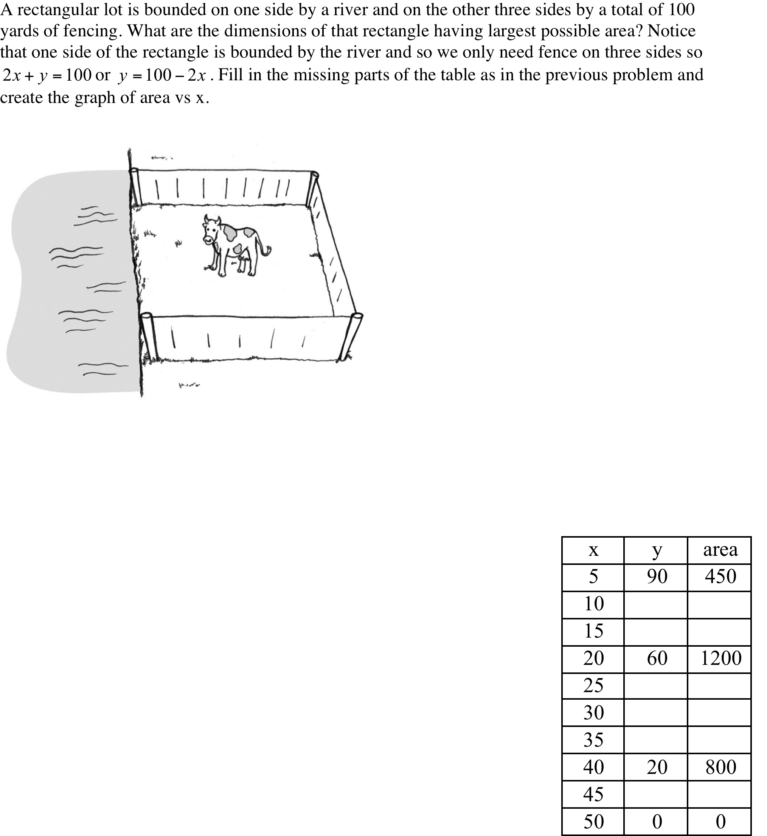
W
A
R
M
-
U
P
What words might English learners have difficulty
understanding?
Notes:
Presenter Notes:
Say: This word problem uses special language, the language of mathematics. Point out the math words rectangular lot, missing parts of the table and dimension.
Explain that English learners will have difficulty with more than math words like graph and dimensions. They will also have difficulty with the word bounded, previous, and create – academic words that are used across content areas. They will also have difficulty using context-specific language like fencing, bounded, and fence.
Point out that most math teachers equate vocabulary instruction in math with math content instruction. They are used to teaching the words the textbooks list,
but they overlook the instruction of other hard words for ELs that students are going to see and hear (and need to use in speech and writing)
not only in math but other subjects. Those other words have big word families and they stump English learners on math tests since they are rarely taught. Content-specific words generally represent big concepts and can't be
modeled or taught quickly. There are usually related concepts that need to be taught with them. They can be reviewed easily, but not front loaded or
taught quickly.

Slide 17
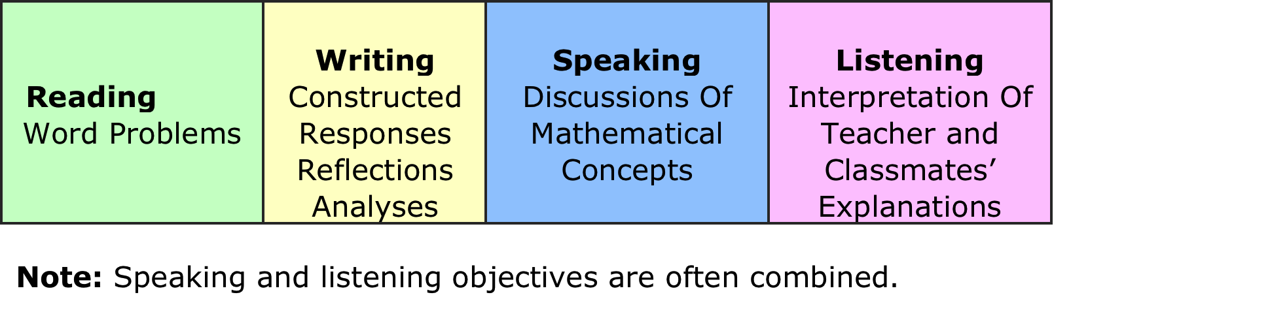
Language Objectives
Objectives should be written for all four modalities:
Notes:
Presenter Notes:
If you like, you can ask participants what students read in their classes? What do they write in their classes? When do their students speak? When do they listen? Emphasize that the Common Core wants students to practice using the Language of Math in all four modalities.

Slide 18
Language Objectives
Identify what students should know about English and do with it in a particular task.
Support the students’ development of English.
Language objectives help students learn language that supports their learning in math classes as well as in other contexts.
Language objectives include a verb (or verb phrase).
Handout: Developing Effective Language Objectives
Notes:
Presenter Notes:
Pass out handout, Developing Effective Language Objectives.
Ask participants to read page 1

Slide 19
Task-Based Language Objectives
Task-based language objectives specify the language students need to learn to complete tasks in mathematics classes.
Language objectives emphasize the development of expressive and receptive language skills.
Language objectives are obtainable.
Language objectives are measurable.
Language objectives support the Common Core State Standards.
Notes:
Presenter Notes:
Ask the participants what expressive means. Remind them that expressive refers to speaking and writing.
Ask the participants what receptive means. Remind them that receptive refers to listening and reading.
If you can’t identify it, you can’t measure it.

Slide 20
Sample Language Objectives
Students will describe their solutions to problems involving exponential relationships using the past tense verbs: determined, concluded, found, …
Students will compare and contrast two graphs using transitions words on the one hand, on the other hand, however, and in contrast and the words (conjunctions) while and although as well as specific comparison structures: more than, less than, twice as much, and the same as.
Notes:
Presenter Notes:
Point out that the verbs in language objectives are almost always followed by a noun that explains what the students are supposed to do.
Ask:
What do students describe in the first language objective?
What do they describe in the second language objective?

Slide 21
Sample Language Objective
Students will revise a paragraph in which they describe a quadratic equation using correct present tense verbs.
Note that language objectives are most effectively communicated using verb phrases:
Students will point out similarities and differences between two solutions using the words similar to and different from.

Slide 22
Sentence Frames
Students will (verb phrase) using (target language).
Students will use (target language_) to (verb phrase).
Notes:
Presenter Notes:
Make sure to point out that these sentence frames will make their task of writing language objectives easy. If they use either of the sentence frames, they will obtain much success.
Point out that they do not have to use these specific sentence frames.
If they prefer to write student-friendly sentence frames, they may do so.
Some teachers like this alternate sentence frame: Students can (verb phrase) using (target language).
Tell the participants that the hardest part is coming up with the target language.
The target language = the language that they want the students to learn.
The teachers need to list this language, being as explicit and as student-friendly as they can.
They should avoid using technical language like “subject,” “predicate” or “transitive verb” that the students may or may not understand.

Slide 23
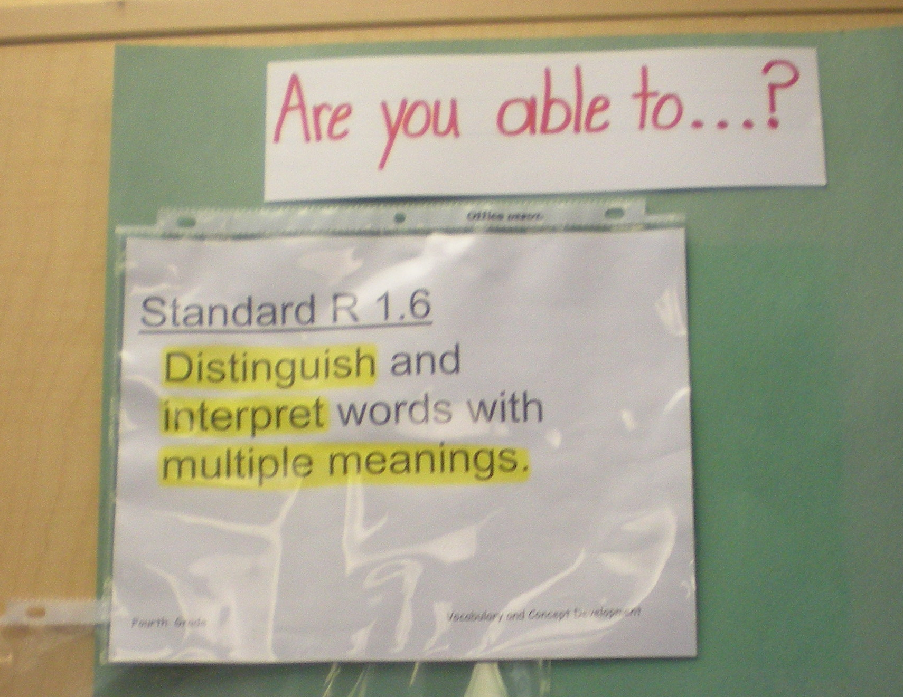
The language objectives can be written in student-friendly language.

Slide 24
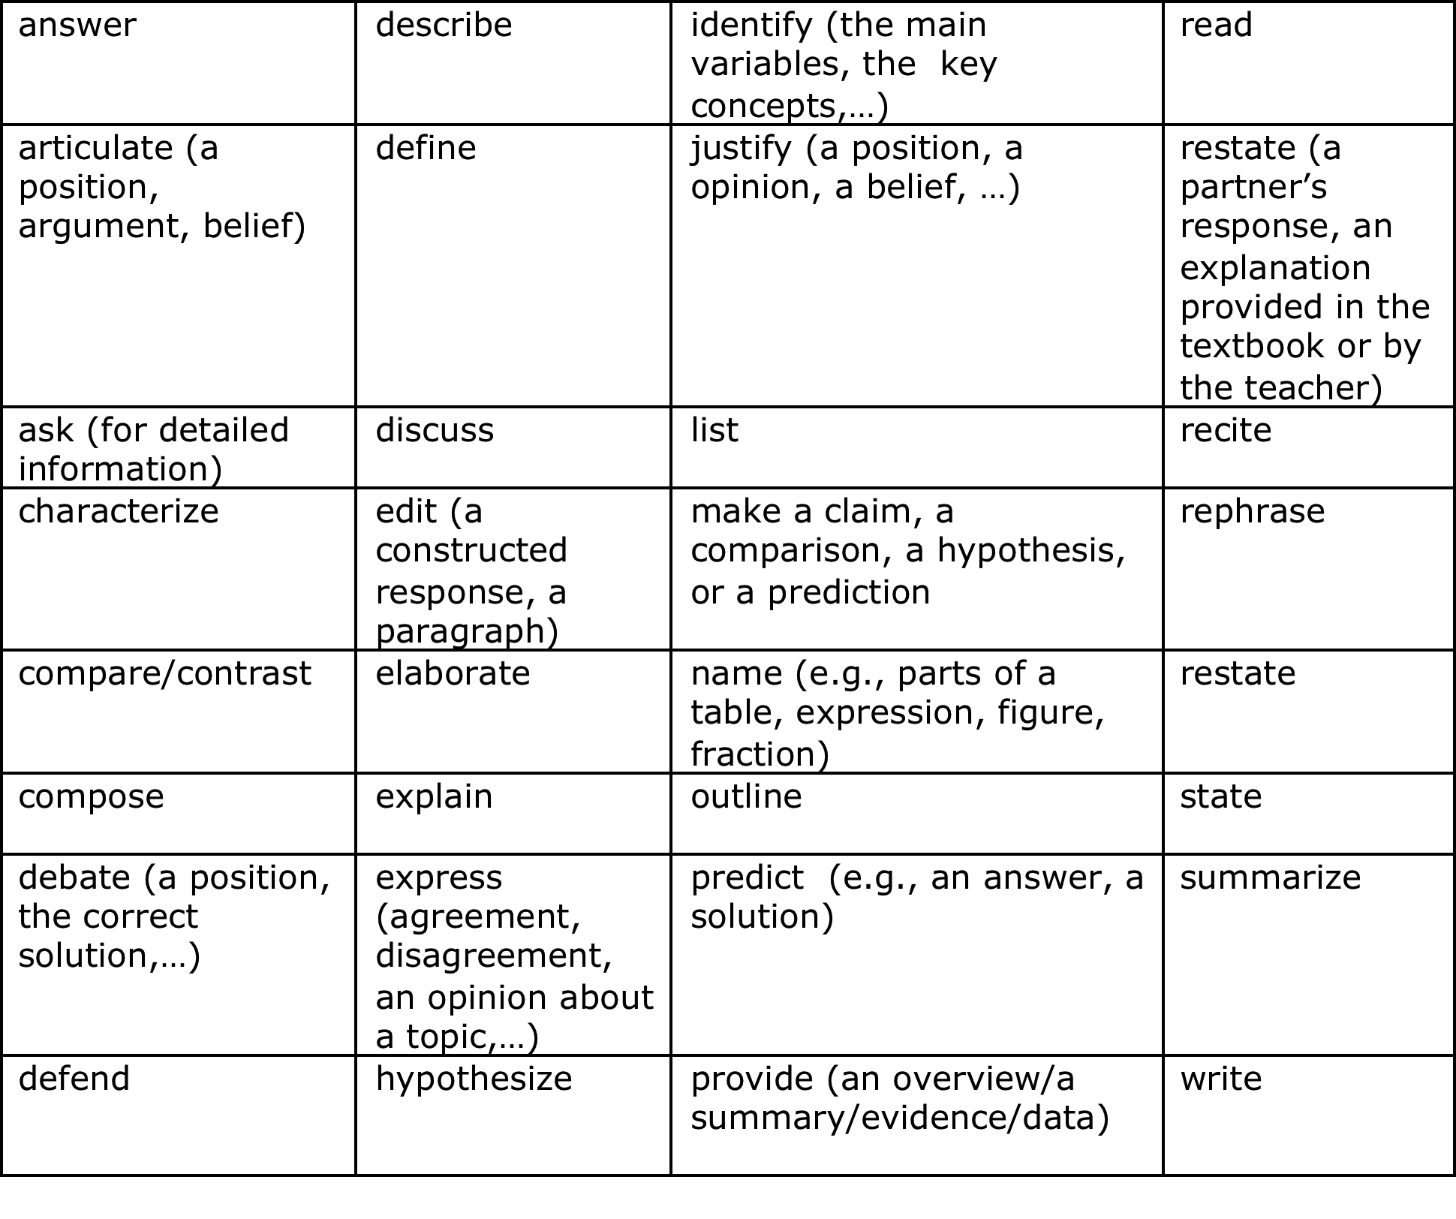
Examples of Verbs Used In Language Objectives
Notes:
Presenter Notes:
Ask participants to refer to page 2 and discuss the verbs/and verb expressions used in language objectives.
Ask the participants which verbs elicit language that is easy for English learners to use (list, name, state, restate) and which verbs elicit language that is more difficult for English learners to use (hypothesize, debate, defend, hypothesize).

Slide 25

Read pages 2 - 4 of the handout. Put a check next to two objectives in reading, writing, and listening & speaking that you might use when teaching your students functions in Algebra. Compare your choices with a partner.
A Review: Sample Language Objectives
Notes:
Presenter Notes:
Give the participants time (5 to 10 minutes) to read the handout and select two objectives in reading, writing, and listening & speaking.

Slide 26
Target Language
The language teachers want their students to know to understand math instruction and to participate effectively in math lessons.
The target language could be vocabulary words or grammatical structures.
It could be a specific sentence structure (e.g., learned with a sentence frame).
Handout: Developing Effective Language Objectives, pages 4-5
Notes:
Presenter Notes:
Remind teachers that if they decide to teach a sentence structure in a sentence frame, they need to list the sentence frame.
They cannot just say “words.” They need to write the specific “words” that they want their students to learn.
In this way, they can hold students accountable for learning the words.
Note: Math teachers have a tendency to include math content words as target language. When asking teachers to write their own language objectives, tell them that while they could include math words, in the assignment you are giving them today, you would like them to include other words than math words in their language objectives. They might include transition words (like “first,” “second,” or “third,” academic words from the Academic Word List, or quantifiers (some, any, many, numerous). They can use any words that help students understand and use mathematics concepts.

Slide 27
The key is to make intentional decisions…
Am I trying to teach language?
If so, what language?
Words? Which ones?
Sentence structures? Which structures?
Language functions, like justifying an answer or comparing two answers?
Why do students need to know these specific words, sentence structures, or language functions ?
Will students use them in reading, writing, speaking and/or listening tasks?

Slide 28
Consider your instructional time… Also, consider…
The students and their needs (e.g., what language they already know and their understanding of math concepts)
Their environment (including teacher and student resources, the classroom seating configuration)
The ways in which specific language supports math instruction and learning
What else?

Slide 29
Key Points
Language objectives are communicated to students clearly, both in speech and writing.
They can be posted in the classroom.
They can be referred to before, during, and after a task.
The language features you teach should be modeled, taught, practiced, applied to math learning, and assessed.
Notes:
Presenter Notes:
Point out the examples of language expressions on page 6 of the Developing Effective Language Objectives handout

Slide 30
Writing Language Objectives
Review the handout, Developing Effective Language Objectives
Work with a partner and using the sentence frames page 8, write one or two language objectives. See page 8.
Handouts: K-12 Universal Access/SDAIE Lesson Design Template
Developing Effective Language Objectives
Notes:
Presenter Notes:
Give participants an additional two or three minutes to review the language objectives handout.
Ask participants to work with a partner to develop related content and language objectives and write them in the lesson design template.
If time permits, ask for volunteers to read their objectives.
Have participants work with a partner to write related content and language objective using page 7 of the handout.

Slide 31
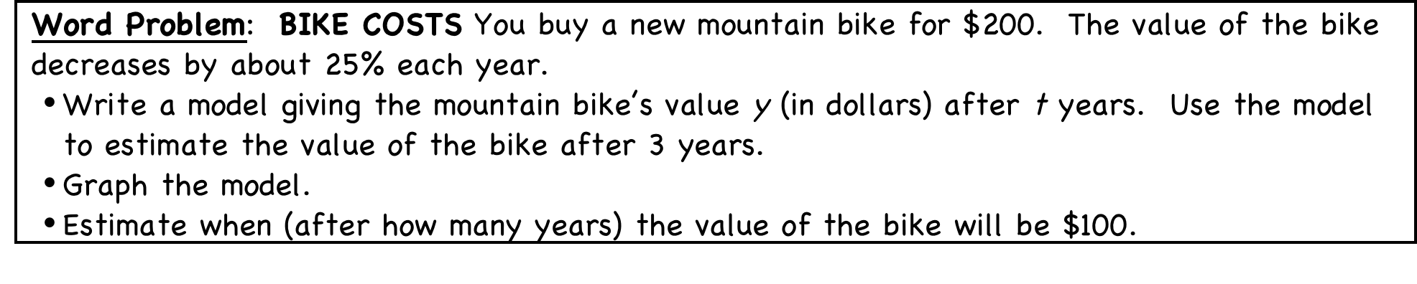
Activity: Write 1-2 language objectives you might use when teaching this problem.

Slide 32
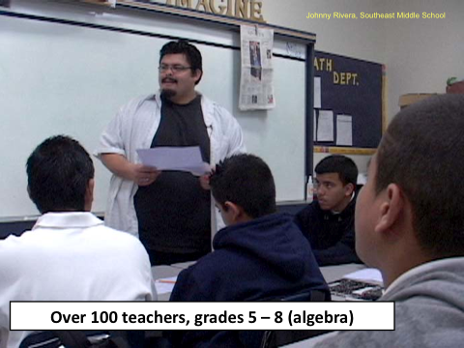
TEACHING WORDS
It’s not enough to hold students accountable for learning language. We need to support their learning of language.

Slide 33

Why Be Concerned about Vocabulary
Knowledge of vocabulary is one of the best predictors of success in all school subjects.
The more words students know, the easier it is to learn new words because they have more “pegs” to hang the new words on.
Lack of vocabulary can prevent student success in mathematics classrooms.

Slide 34
What Can You Teach Students about Words
Include:
spelling
pronunciation
opposites/antonyms
synonyms
related words
examples/non-examples
use in math contexts in complete sentences
multiple meanings
Notes:
In-depth knowledge of a word means much more than just dictionary definitions. It includes teaching the multiple meanings of words, and how that word is being used in the context of the content subject reading that is being used in class. Note that 70% of the most frequently used words have multiple meanings (Bromley, 2007).
Emphasize the importance of knowing the correct spelling and pronunciation of a new word: For example, specific/Pacific sound or look very similar, but have very different meanings.
Also point out the value of exposing students to non-linguistic forms of a new words, such as a picture or association of an object to the word.

Slide 35
Teaching words with multiple meanings
Notes:
Notes for Presenter:

Slide 36

What types of words are taught when teaching algebraic concepts?
EVERYDAY WORDS: Words that are used the same ways in math contexts and in ordinary English (dollars, cents, because, balloons, distance…)
ACADEMIC WORDS: Words used in different content areas
TECHNICAL WORDS: Words that are used only in mathematics – technical words - (hypotenuse, square root, numerator…)
---------------------------------------------------------------------------
WORDS WITH MORE THAN ONE MEANING: Words that have different meanings in mathematics contexts than they do in other contexts
Notes:
Notes for Presenter:
Quotes taken from
Boaler, J., & Brodie, K. (2004). The importance, nature and impact of teacher questions. In D. E. McDougall & J. A. Ross (Eds.), Proceedings of the 26th annual meeting of the North American chapter of the International Group for the Psychology of Mathematics Education (Vol. 2, pp. 773-781). Toronto: Ontario Institute of Studies in Education/University of Toronto.

Slide 37
Examples of math words with multiple meanings
operation
power
problem
plot
table
area
face
plane
tree
These words can prevent English learners from understanding their math instruction.

Slide 38
A Word with Many Meanings: Unit
Definitions
a. a set quantity as a standard of measurement
b. a part of a military organization
c. a part of a school course focusing on a theme
Task: Match the definitions of unit to the sentences that follow:
Fifty soldiers reported to that unit.
2. This unit is on tools for calculating size.
3. Grams is the customary unit for medicine.
The answers = b, c, a

Slide 39
WORDS WITH MULTIPLE MEANINGS: Consider the word variable
In everyday contexts, the noun variable means something that can vary.
There are many variables we need to consider before we make a big decision.
In everyday contexts, the adjective variable means able to change, inconsistent or fickle.
The weather is variable.

Slide 40
Let’s consider how the word variable is used
in math contexts.
In Algebra, we can use letters to represent one or more variables, symbols for unspecified quantities. When a letter is used to represent a range of numbers, it is called a variable. The numbers are called values of the variable.
An expression that represents a particular number is called a numerical expression.
constants - numbers
variables - letters
A variable expression consists of constants, variables and operations. (It is not a group of words that changes.)

Slide 41
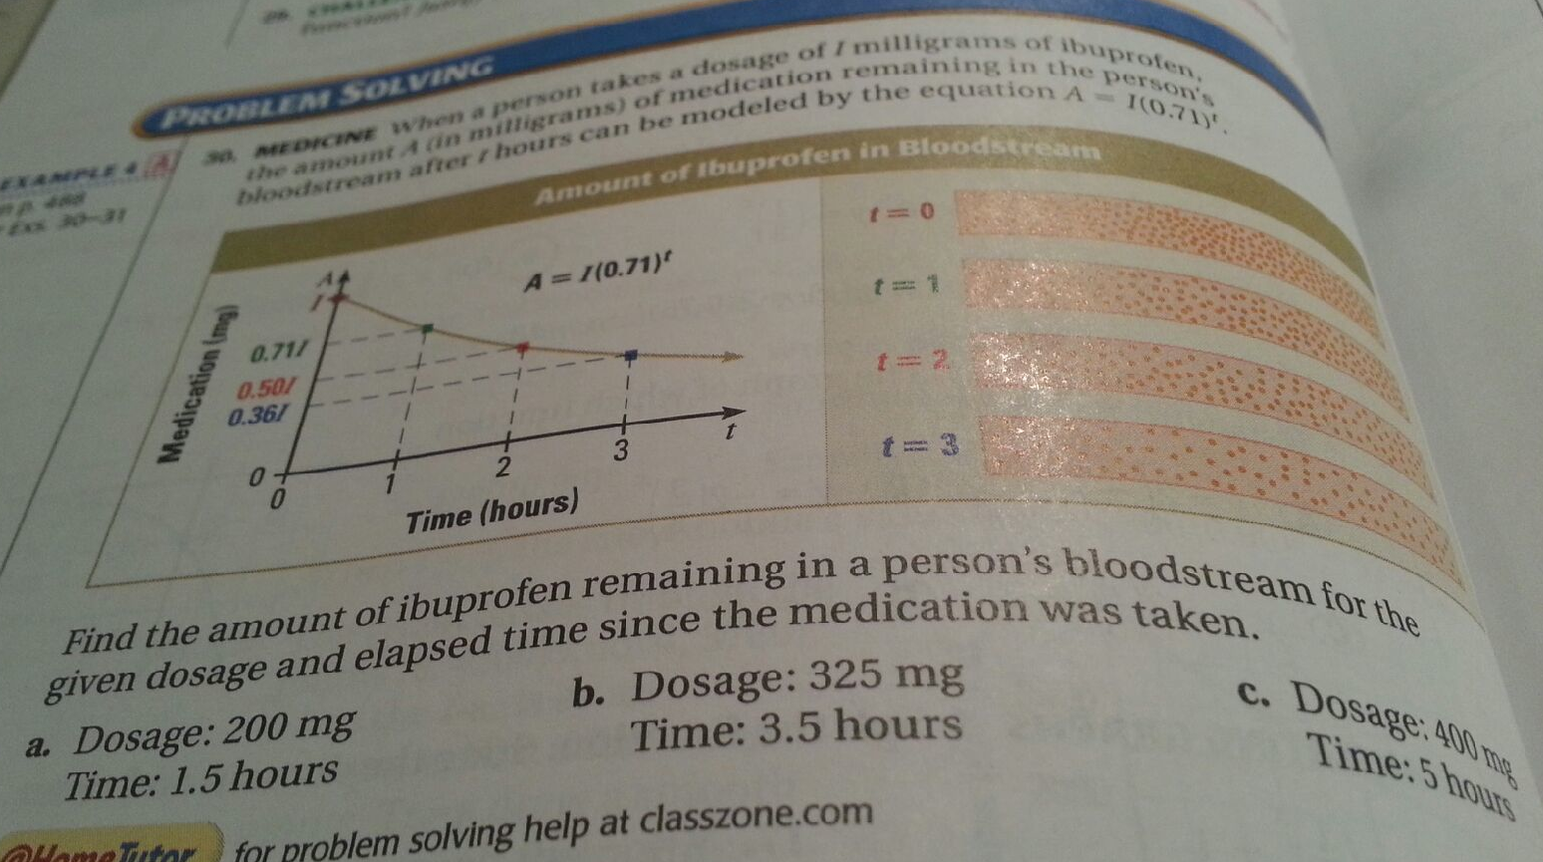
Task: Read the problem silently. When a person takes a dosage of t milligrams of ibuprofen, the amount A (in milligrams) of medication remaining in a person’s bloodstream after t hours can be modeled by the equation A = I(0.71)^{t}. Find the amount of ibuprofen remaining in a person’s bloodstream for the given dosage and elapsed time since the medication was taken.
Are there any words in this word problem with multiple meanings?

Slide 42
Did you think of these words?
to model (CORE EVERYDAY MEANING): to work as a fashion model, to sculpt
given (CORE EVERYDAY MEANING): A verb used to indicate that someone presents or delivers something to someone else

Slide 43
Mathematics Words: Content-Specific Vocabulary
In mathematics, the use or definition of a word is
often different or more precise than it is in other subjects.
Exponential
Everyday Contexts | Mathematics Contexts
An increase in number or size. | An increase in number or size, at a constantly growing rate.
Notes:
43

Slide 44
Teaching words with multiple meanings
Homophones are words that
- sound the same
- but are spelled differently
- and have different meanings (too, two, to; some, sum)
Words with multiple meanings are those that
- sound alike
- are spelled alike
- but have different meanings (trunk, trunk, etc.)

Slide 45
Put Your Heads Together
Write 3 words with
multiple meanings you could
teach in your classroom:
IMPLICATIONS for instruction:
1.
2.
3.
Notes:
What are 3 things that you want to discuss with your colleagues?
Why are these important?
What implications do they have for your teaching?
For your school?
For your program?
Vocabulary knowledge in kindergarten and first grade is a significant predictor of reading comprehension in middle and secondary grades (Cunningham & Stanovich, 1997)

Slide 46
Teaching Academic Words
Notes:
Notes for Presenter:

Slide 47
Teachers can get more bang for their buck by teaching academic words quickly and systematically than they do from teaching content-specific words. This is because academic words have big word families. Once students learn the meaning of one academic word, like “significance,” it is easy for them to learn the meaning of related words, like “signify,” and “significant.”
What Words Do Teachers
Need to Teach?
Handout: Academic Word List
Notes:
Presenter Notes:
Remember that math teachers find it easiest to teach math content words and frequently overlook academic words that many English learners have difficulty learning.
Reinforce that most content specific vocabulary is taught over long periods of time with explanations, visuals, tables, and pictorial representations. To teach most content-specific words like quadratic teachers must teach a number of concepts such as roots, polynomial, variable and constant.
Teachers get more bang from teaching academic words quickly and systematically than they do from teaching content-specific words. This is because academic words have large word families. Once teachers teach one academic word, such as “indicate, it is easy for students to learn the meanings of related words, such as “indication” and “indicative.”

Slide 48
Example of Academic Words
Apply
Assume
Contain
Select
Maintain
Access
Determine
Specify
Minimum
Release
Survive
Identify
Inevitably
Coherent
Persist
http://www.victoria.ac.nz/lals/resources/academicwordlist/
Notes:
Notes to Instructors:
Academic words are listed from most frequent (1) to least frequent. (10) The list of academic words is widely available and used in test and textbook construction, Grades 6-12. Emphasize that the words are not SAT words, but highly useful words that students encounter frequently in a number of academic settings.
The AWL is made up of about 850 words taken from university level academic writing (textbooks in the areas of the arts, business, law and science.

Slide 49
Basic Steps to Teaching Academic Vocabulary
Step One: Getting the students ready and
engaging their interest.
Step Two: Teaching the word explicitly.
Step Three: Providing independent practice.
Step Four: Providing formative assessment.
Handout: Basic Steps to Teaching Vocabulary
Notes:
Presenter Notes:
Tell participants that there are many ways to teach words. This is one way that works well when teaching academic words.

Slide 50
Step One: Getting the students ready and engaging their interest.
Signal that vocabulary instruction will take place and explain why. | Today we are learning new vocabulary. I will ask you to use this vocabulary when you do your peer work and make your oral presentations in front of the class. You will also find the word useful in your writing assignment. The first word you learn is an important one. You will use it in most your classes.
Specify what the students will do. | You will listen, repeat the word and use the word orally and in writing.
Prepare the students to take notes. | You will take notes as I explain the word.
Notes:
Presenter Notes:

Slide 51
Step Two: Teaching the Vocabulary Explicitly
Introduce the new word. | The new word is the word evaluate.
Pronounce the new word clearly a few times. | Listen to me pronounce the word. EVALUATE
Ask your students to pronounce the word after you. Break up polysyllabic words. | Please repeat the word after me. e-VAL-u-ate
Notes:
Presenter Notes:

Slide 52
Step Two: Teaching the Vocabulary Explicitly
Write the word on the board or overhead and point to it. Tell students to read and write it | evaluate
Teach the meaning of the word by giving the students a student-friendly definition. | Evaluate means to judge how good, useful, or successful something is. You should be able to evaluate your own work.
You can sometimes find useful definitions in the Longman’s on-line dictionary, http://www.ldoceonline.com/. | Evaluate your answer to determine whether or not it is correct. Evaluate the outcome of your plan.
Notes:
Presenter Notes:
Remind teachers that students do not read much and often avoid reading. A good way to get them to read is to point to the word on the board and make sure you see the participants’ eyes tracking as they read out loud with you. Say, “I like the way this side of the class is tracking with their eyes.” and “I like the way this side of the class repeats after me chorally.”

Slide 53
Step Two: Teaching the Vocabulary Explicitly
Provide student-friendly examples and lots of example sentences. Tell students to write them. | 1. Your writing will be carefully evaluated over the coming months. 2. Let's evaluate the expression 3y + 2y when 5 = y. 3. We can evaluate web sites to see how good they are.
 | 4. Why does he always evaluate his brother so critically?
Notes:
Presenter Notes:
Remind teachers that students do not read much and often avoid reading. A good way to get them to read is to point to the word on the board and make sure you see the participants’ eyes tracking as they read out loud with you. Say, “I like the way this side of the class is tracking with their eyes.” and “I like the way this side of the class repeats after me chorally.”

Slide 54
Step Two: Teaching the Vocabulary Explicitly
Near synonyms: assess calculate check out carefully weigh / consider carefully (weigh/consider carefully the evidence) Evaluation results in a measurement of something’s worth. It is a judgment of something. | Near opposites: guess decide without looking at evidence not check out the facts
The word evaluate is a verb that is usually followed by an object. | People evaluate something.
Words that go with evaluate: | reports, word problems, answers, people, music
Notes:
Presenter Notes:
Ask, “Is everyone taking notes?”

Slide 55
Step Two: Teaching the Vocabulary Explicitly
In mathematics contexts, evaluate has a meaning that is more precise than it is in everyday situations. In math, evaluate means to accurately figure out the numerical value of something (such as a function or a set of numbers, or a relation). | In everyday contexts, evaluate just means to figure out (in general-not numerically) the worth or quality of something.
The word evaluate is a verb that is usually followed by an object. | People evaluate something.
Words that go with evaluate: | reports, word problems, answers, people, music
Notes:
Presenter Notes:
Ask, “Is everyone taking notes?”
55

Slide 56
Step Two: Teaching the Vocabulary Explicitly
Give students additional information about the word so that they can use it. You could explain its related word forms, the words it is used with, and/or the particular way it is used. | Evaluate = a verb Evaluation = a noun Evaluative = adjective
Guide the students in reading sentences containing the word two or three times. | 1. The doctor evaluates the patient’s health. 2. In recent years, it has become very important to evaluate the information we read in the newspaper.
 | 3. It is important for students to evaluate their situation. 4. Before we do what John tells us to do, we should evaluate his plan.
Notes:
Presenter Notes:
For ideas for constructing sentences, see http://sentence.yourdictionary.com/

Slide 57
Step Three: Provide Independent Practice
In this step, you need to use a familiar instructional strategy to engage students in an activity.
Pair Work | Find a partner. Interact for three minutes. Use sentence frames that I give you to practice using the word evaluate in complete sentences.
Sentence Frames | After the new advertising strategy was used, we decided to evaluate its effectiveness. After the teacher quit, we decided to evaluate the reason.
Notes:
Presenter Notes:

Slide 58
Step Three: Provide Independent Practice
Take turns completing these sentences with the word evaluate.
After the Dodgers won so many ball games, we decided to evaluate…
After my friend got sick when he ate his brother’s cooking, we decided to evaluate…
After the student gave up trying to do well in her class, we decided to evaluate…
After the success of the new movie, we decided to evaluate…
Notes:
Presenter Notes:

Slide 59
Step Three: Provide Independent Practice
Sentence Completion
The evaluation of poverty in the United States shows that…
The evaluation of the increase in students’ math scores shows that…
The evaluation of the increase in the cost of health insurance in the United States shows that…
The evaluation of the decrease in the purchase of cars in the United States shows that…
Notes:
Presenter Notes:

Slide 60
Step Four: Provide Formative Assessment
Hold each student accountable for using the word. Provide feedback, as appropriate. For example, ask each student to use the word to complete a task in which they write a complete sentence using the word. | Task: Write two complete sentences using the word evaluate.
Notes:
Presenter Notes:
Make sure to ask the teachers to write a sentence using the word “evaluate” just to show them how quickly the task can be done and how easy it is to correct just a single sentence of student writing

Slide 61
Model of Academic Vocabulary Instruction
preparation explicit teaching modeling practicing applying assessing
Increasing Independence

Slide 62
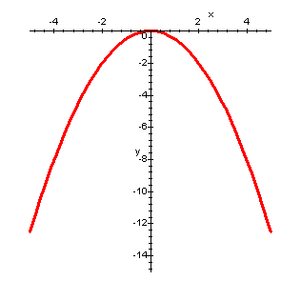
What to do about Content Vocabulary
Parabola
Teach it very carefully over days and weeks.
Whenever possible, use visuals to remind students of the meanings of new words.

Slide 63
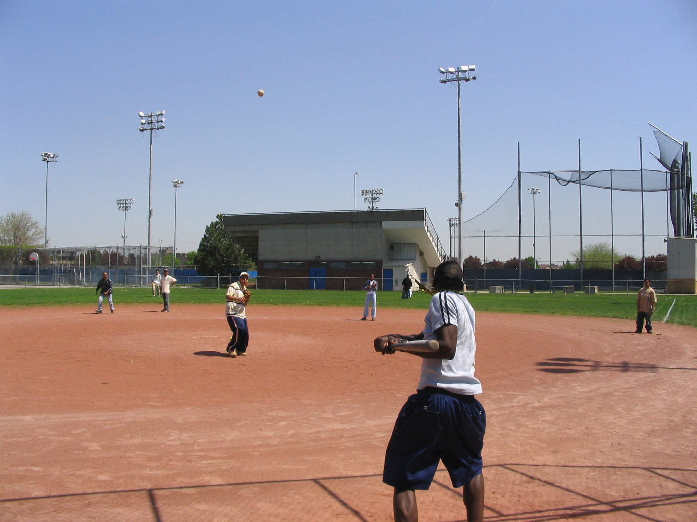
Use visuals.
Parabolas are the shapes that define projectile motion (the path that a ball takes when it is hit or thrown into the air).

Slide 64




Parabolas show up in the architecture of bridges.

Slide 65
Teaching Language Functions
Notes:
Notes for Presenter:

Slide 66
Language Demands from the Common Core State Standards
The Common Core State Standards set high expectations for all students to participate in academic discourse across the disciplines.
Notes:
1 minute

Slide 67

Key Shift
CA Math Standards From… |  | Common Core Standards To…
Using language functions to communicate ideas, analyze them with evidence, and justify reasoning was not emphasized much. | → | Using language functions to communicate ideas, analyze them with evidence, and justify reasoning is greatly emphasized; Students are held accountable for their ability to use language functions.
Spycher, 2012
Notes:
Time: 1 minute
Intent: Introduce the key shifts in the ELD standards.
Talking points:
How many of you had the opportunity to read the ELD standards? Please raise your hand if you are familiar with the new California ELD standards.
Slide 4, 6, & 9 only include three of the key shifts. The remaining shifts can be found in Appendix B of the ELD standards.

Slide 68
Function: A word with multiple meanings!
Language Function: What students do with language
Examples:
• making a claim,
• justifying an answer,
• comparing,
• giving directions,
• defending a position

Slide 69
Language Functions
Additional Examples
Prediction | Analysis
Identification | Classification
Interpretation | Comparison/Contrast
Explanation | Definition
Description | Inference/hypothesis
Retelling | Summarization
Notes:
Our colleagues who come from the fields of linguistics and second language acquisition use the term “language functions” for the examples listed above.
See: Schleppegrell. M. J. (2004). The language of schooling: A functional linguistics perspective. Mahwah, NJ: Lawrence Erlbaum Associates, Publishers.
Halliday, M. A. K. & Hasan, R. (1989). Language, context, and text” Aspects of language in a social-semiotic perspective. Oxford, England: Oxford University Press.
References:
:

Slide 70
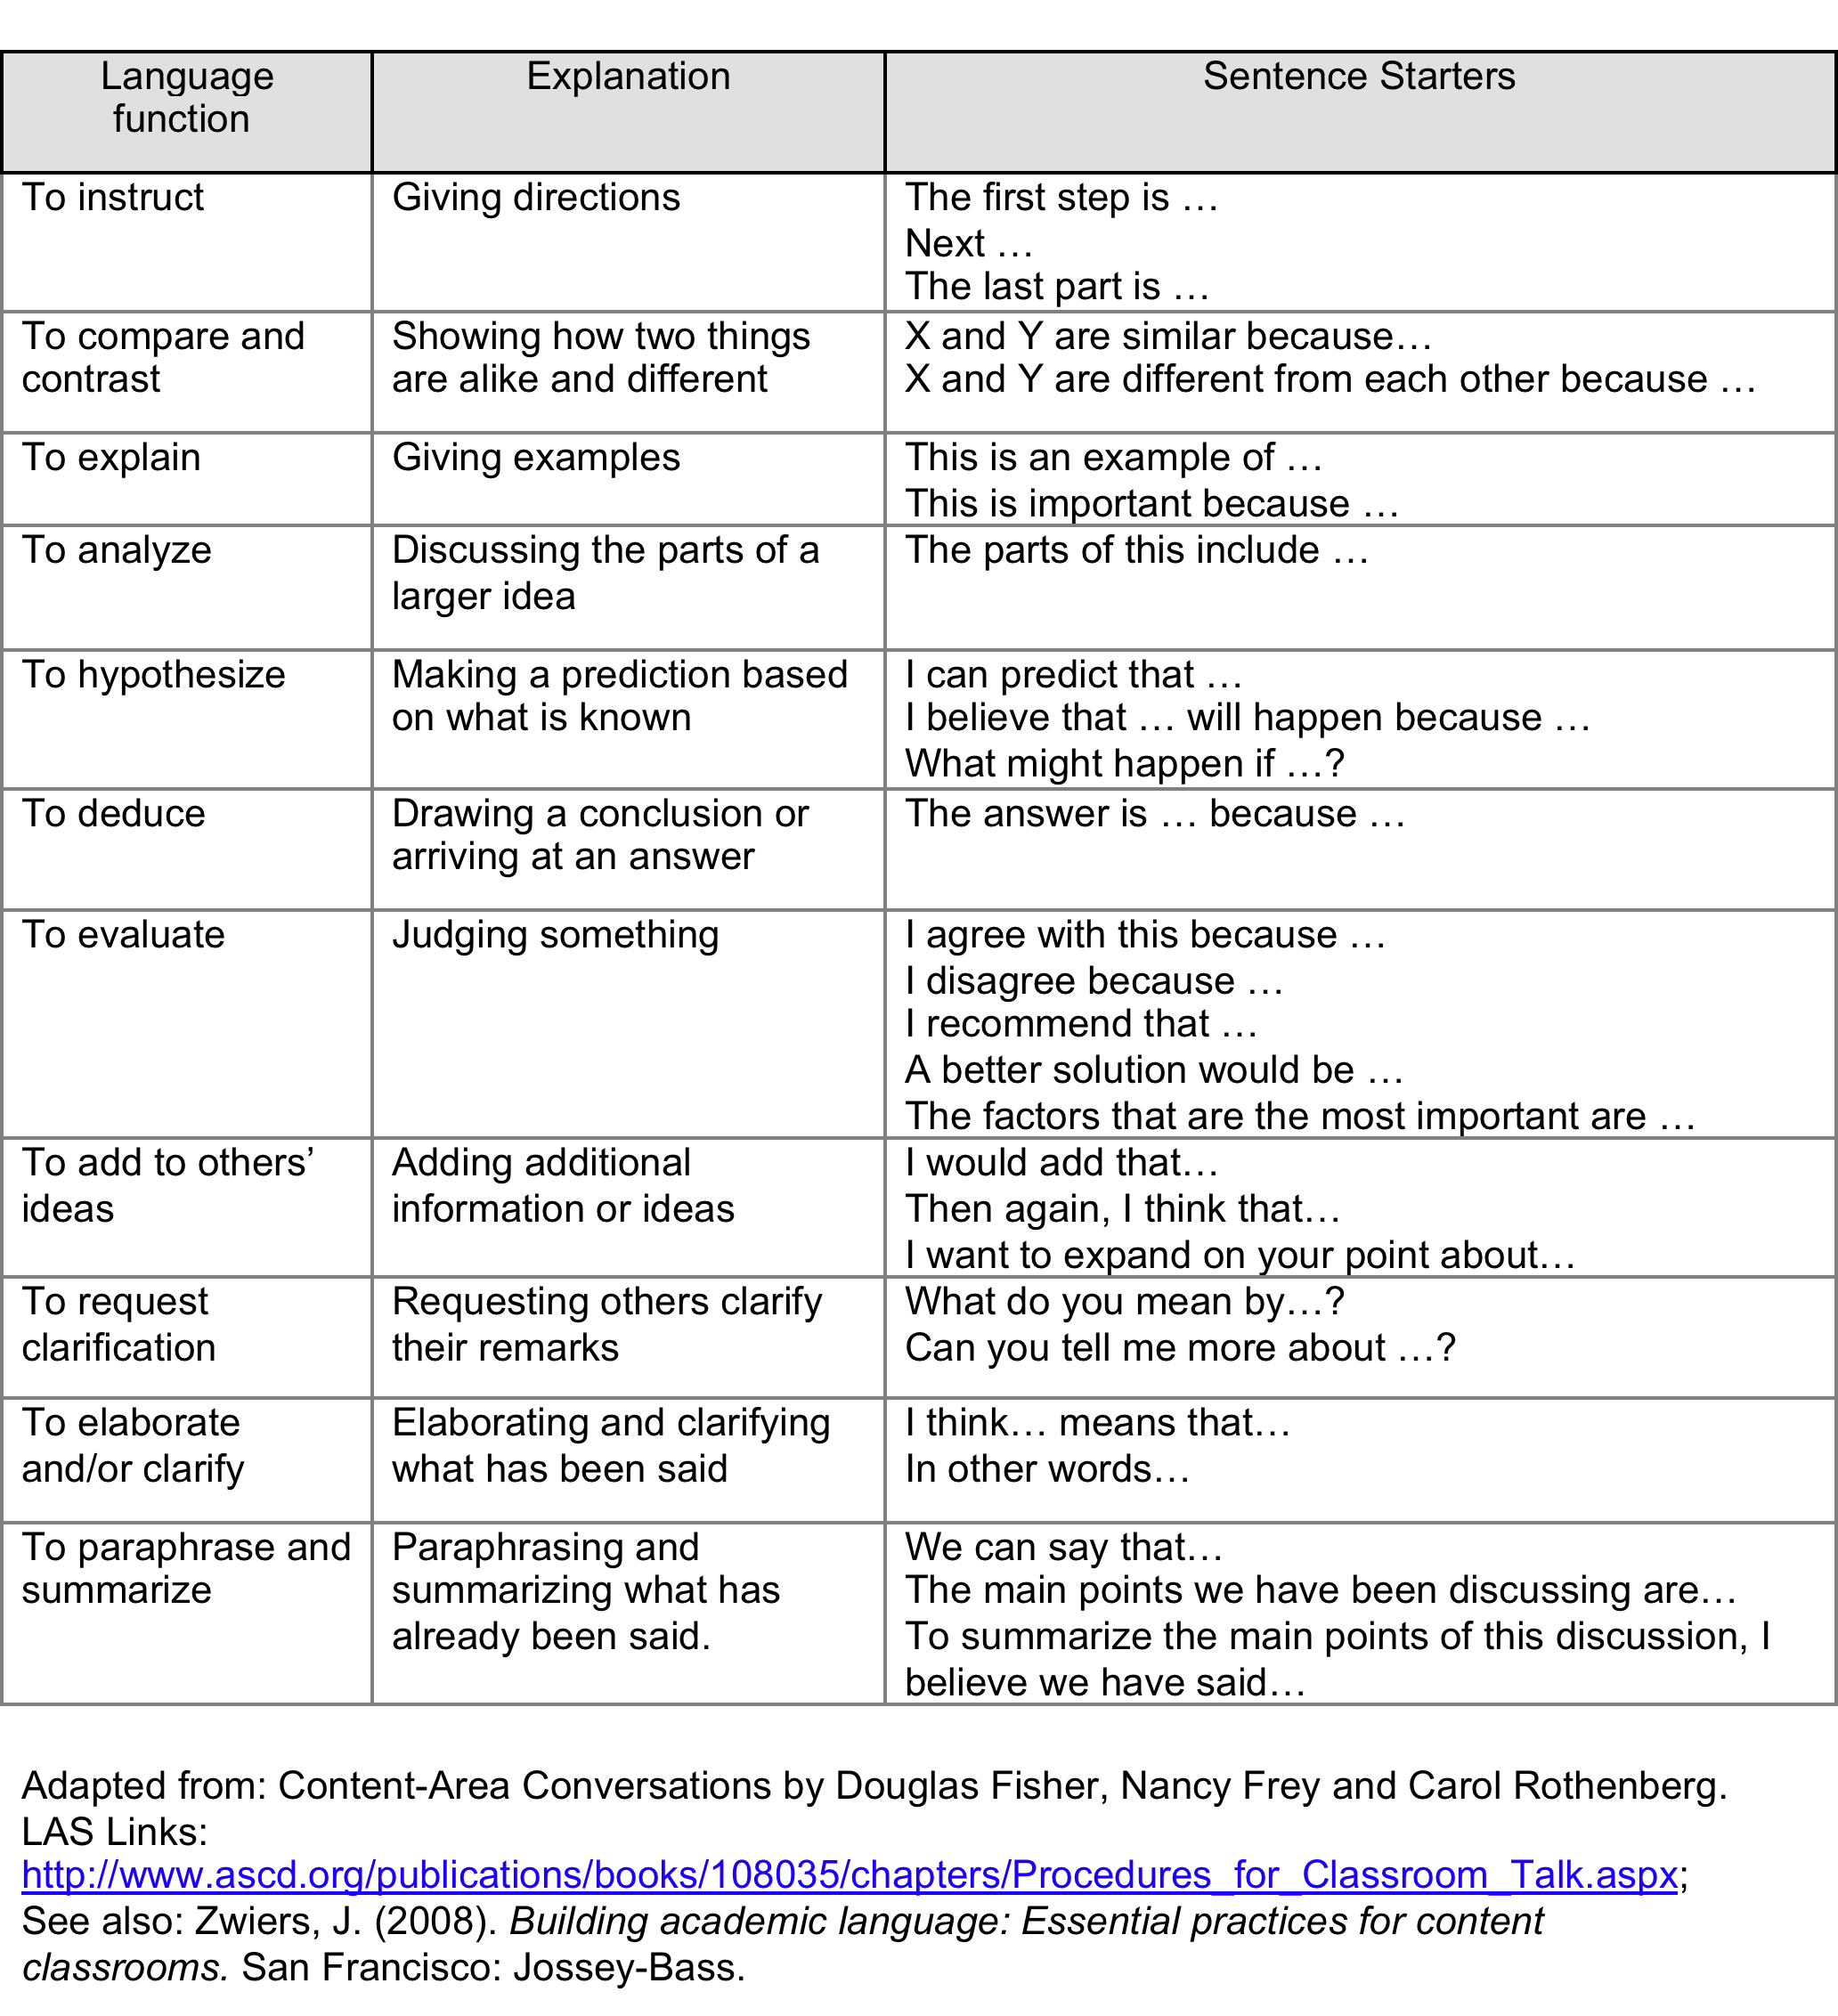
Teaching Language Functions with Sentence Starters
Handout: Teaching Language Functions with Sentence Starters

Slide 71
Frames and Starters
Why do we need them?
What is the difference?
Both CAN teach language.
Sentence framse and starters can elicit student thinking.
Sentence frames tend to teach language structures more explicitly than sentence starters.

Slide 72
Sentence Starters…
Depending on the way sentence starters are structured, they can provide little structure for accurate responses
My answer is reasonable because _____
They can leave it to the students to figure out how to construct the sentence.
If I were buying a car, then ___
They may result in erroneous language use.
If I were buying a car, then ___ I gotta save a lot of monies.
They can be much more difficult for teachers to assess than sentence frames.

Slide 73
Quick Quiz: Sentence Frame or Starter?
I discovered _________________.
The differences between _____________ and ____________ are____________( with prompt and word bank)
My classmate mentioned _______________________ and illustrated the point by emphasizing that ____________________________ (used after discussing word problem).
The answer is correct because _______________.
I agree with _______’s idea and I’d like to add __________.
The first step is to __________________.
Notes:
Show your answering using the sign language sign for S
Or
F

Slide 74
Language Function: Comparisons
Comparing involves knowing how to use expressions of comparison – like more than, less than, greater than, and adjective – er and –est constructions.
This triangle is larger than than triangle.
Handout: Teaching Language Functions
Sentence Frames: Using the Language of Comparison

Slide 75
Language Function: Comparisons
In algebra, students are frequently asked to compare. They compare graphs, tables, word problem solutions, equations, and functions.

Slide 76
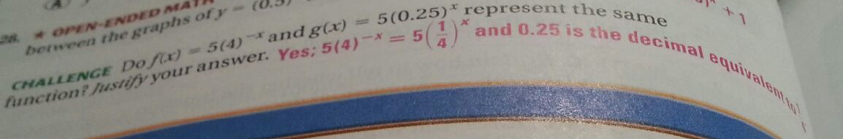
Challenge: Do f(x) = 5(4)^{-x} and g(x) = 5(0.25)^{x} represent the same function? Justify your answer.
Yes; 5(4)^{-x} = 5 (¼)^{x}
And 0.25 is the decimal equivalent of ¼.

Slide 77
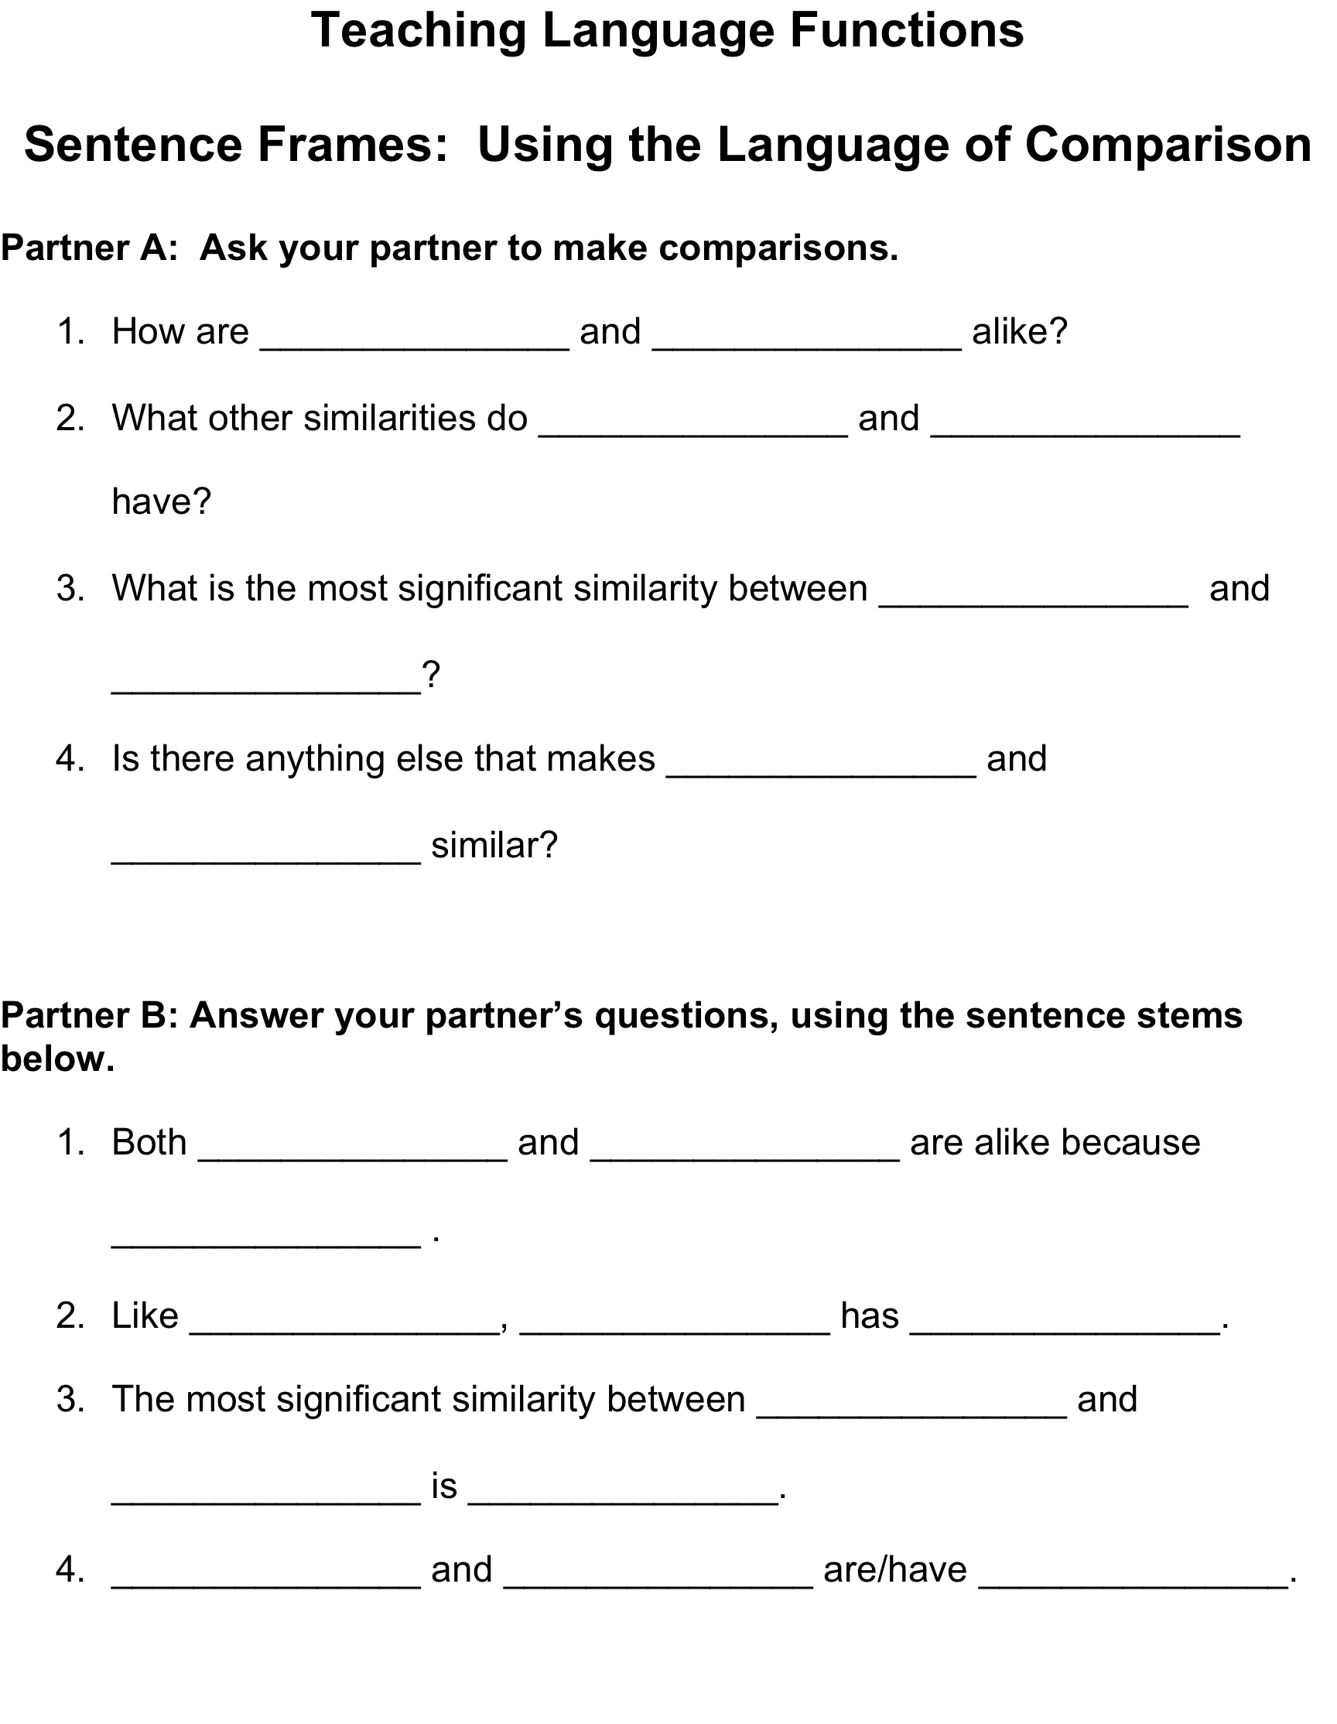
Language Function: Comparisons
How are percentages similar to decimals?
Handout: Teaching Language Functions
Sentence Frames: Using the Language of Comparison

Slide 78
Language Functions: Analyzing
What is the language function, analyzing? Using language to separate wholes into parts and to identify relationships
How do you know if students need to use the language function of analyzing? When you see words like examine, investigate, break down, or determine, students need to use the language function of analyzing.
Handout: Language Functions: Language Functions: Teaching the Language of Analyzing with Sentence Starters and Frames in the Math Class

Slide 79
Language Functions: Analyzing
Task: First, familiarize yourself with the word problem that will be given to you and its answer.
The table below depicts the amount depreciation of a car each year t since it was new. Show that the ratio of depreciation amounts for consecutive years is constant. Then write an equation that gives d as a function of t.
Next, find a partner.

Slide 80

A Challenge: There is a lot to teach in all classes, especially in Algebra!
1
English
2
Learners
3
4
5
Academic
Success
Notes:
Instructor Notes: The English learners have various levels of English proficiency (1-5).
Teachers must help ELs access and build skills to master English and math.
The concept of a freeway with an onramp is no longer supported by the Common Core. English learners now have to jump on the freeway, leap into the middle lane and go as fast as they can, not only catching up but also excelling.

Slide 81
Key Shift
1999 CA ELD Standards From… |  | 2012 CA ELD Standards To…
ELD Standards as “junior” ELA Standards or as an “onramp” to the ELA Standards | → | ELD Standards working in tandem with language objectives and the Common Core Standards for Mathematics are seen as the “diamond lane” for acceleration
Spycher, 2012
Notes:
Time: 1 minute
Intent: Introduce the key shifts in the ELD standards.
Talking points:
How many of you had the opportunity to read the ELD standards? Please raise your hand if you are familiar with the new California ELD standards.
Slide 4, 6, & 9 only include three of the key shifts. The remaining shifts can be found in Appendix B of the ELD standards.

Slide 82

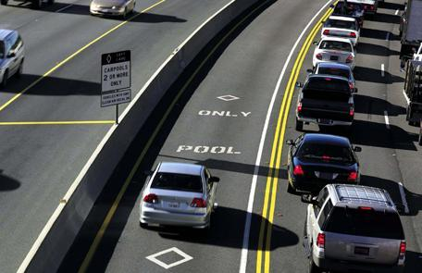
ELD Standards with language objectives
The rigor of English learners’ standards and expectations have
increased exponentially!
Notes:
Time: 1 minute
Intent: Show this visual image of the role of the California ELD standards in relation to English learners’ instruction and expectations.
Talking point:
ELD standards are helping English learners accelerate their language development and academic success just like the cars in the diamond lane are helping the drivers and passengers accelerate their speed.

Slide 83
To Teach the Language of Algebra…
 | HELPFUL | NECESSARY
Include Language objectives
Provide language instruction
Provide language exposure
Provide sufficient practice
Provide feedback
Engage students

Slide 84
What am I learning from this session?
K W L
What do I already
KNOW?
What do I WANT
TO KNOW/learn?
What did I learn/
new questions?
Notes:
2 min: Individual Reflection: What did I learn? What new questions do I have?

Slide 85
PREPARING FOR SUCCESS IN ALGEBRA DEMONSTRATION CENTER
THANK YOU
A Collaboration among:
Los Angeles USD
University of California, San Diego
San Diego State University
University of California, Irvine
Notes:
Presenter Notes:
Let participants know that the materials presented were developed as part of a California Math Science Partnership project involving the district and three universities.
85

Slide 87
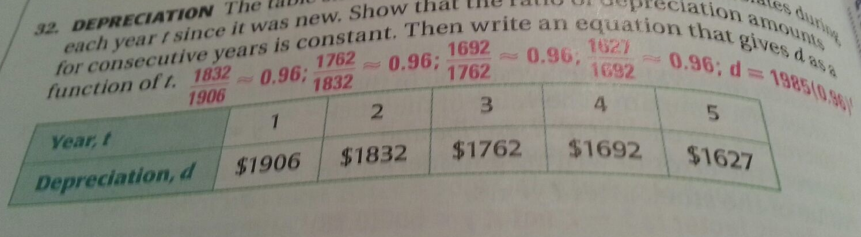
The table below depicts the amount depreciation of a car each year t since it was new. Show that the ratio of depreciation amounts for consecutive years is constant. Then write an equation that gives d as a function of t.

Slide 88
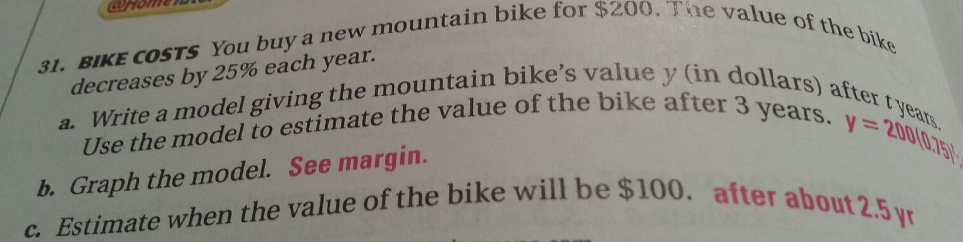

Slide 89
Gradual Release of Responsibility
I
Teacher-focused, modeling, direct/explicit instruction
Guided practice
We
Whole-group, small-group, collaborative
Students move through the stages at different rates, requiring scaffolding and differentiated instruction.
Independent use by student
You
Notes:
This slide represents several teaching principals that should be used by teachers when teaching the Key Vocabulary Routine.
Review concept of gradual release using the I, We, You model.
Briefly explain scaffolding, differentiated instruction, and explicit instruction.
Discuss that some children may require more time with “we” than others and that teachers want to make sure that students are not released too early. We want to set them up for success.
Also point out that cooperative learning to practice strategies has been found to be beneficial in all grades.

Slide 90
Teaching & Learning Framework
Notes:
Presenter Notes:
Point out that this part of the session will focus on information and activities that support Standard 3: Delivery of Instruction of the LAUSD Teaching and Learning Framework, part C. Structures to engage students in learning.

